Slide 1
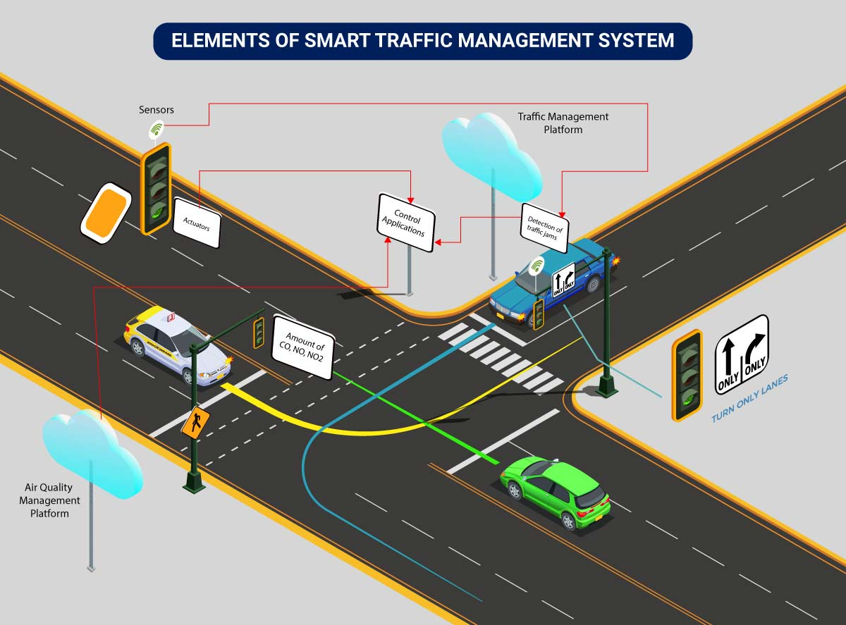


Neuro Fleet X –AI
Powered Fleet Management System
GANESH
-TEAM B

Slide 2

Neuro Fleet X –AI Powered Fleet Management System
PROBLEM STATEMENT
Traffic is becoming hard to control. We need an AI system that shows live traffic, predicts congestion, detects risk zones, and gives the best route for vehicles.
Analyze traffic conditions continuously
Detect congestion before it becomes severe
Identify and highlight dangerous or high-density zones
Optimize travel routes for vehicles (human + autonomous)
Help traffic authorities (managers) monitor and update traffic data
Allow admins to manage system operations effortlessly

Slide 3
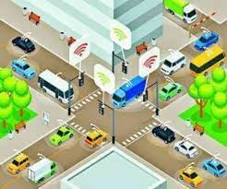
Neuro Fleet X –AI Powered Fleet Management System
SOLUTION:
Our system brings all features into one platform with three main users:
Admin – Controls the entire system
Manager – Monitors and manages traffic
Driver – Uses the route and traffic services

Slide 4
Neuro Fleet X –AI Powered Fleet Management System
ADMIN
MANAGER
DRIVER
Controls the entire platform
Adds managers and vehicles (human or autonomous)
Views all city vehicle movement (live map)
Monitors congestion, risk zones, and alerts
Uses AI reports to make decisions
Monitors traffic flow in different areas
Updates traffic density (for humans driving in crowded areas)
Verifies AI predictions
Checks vehicle statuses (both human + autonomous)
Manages risk zones and congestion alerts
Enters Source → Destination
Receives optimized AI route
Views traffic alerts and risk zone warnings
Updates GPS location
Checks vehicle health and performance

Slide 5
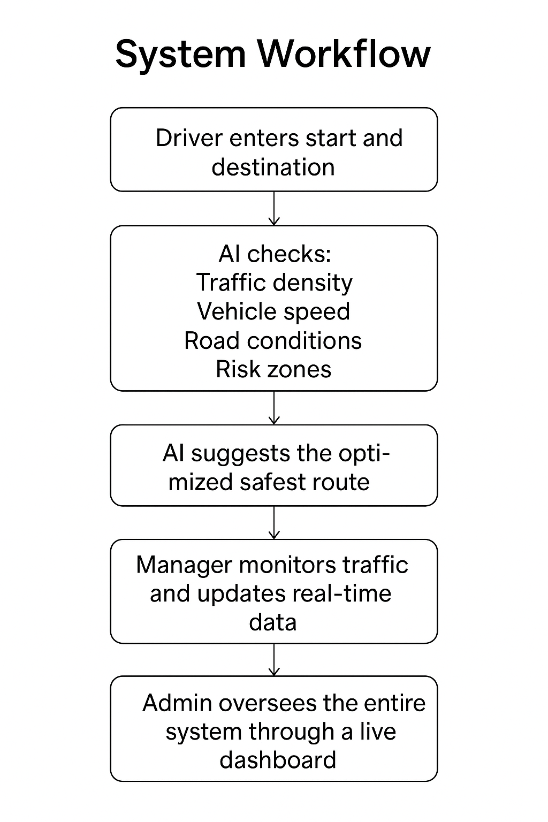
Neuro Fleet X –AI Powered Fleet Management System
System Workflow :
Driver (human or autonomous) enters Start and Destination.
AI checks:
  Traffic density
  Vehicle speed
  Road conditions
  Risk zones
AI suggests the optimized safest route.
Manager monitors traffic and updates real-time data.
Admin oversees the entire system through a live dashboard.
System continually updates predictions to keep routes safe and efficient.

Slide 6

Neuro Fleet X –AI Powered Fleet Management System
My Responsibilities in the Project,
Authentication Module
Designed and implemented the login and registration pages
Secured user access using JWT authentication for all roles
Admin Module Responsibilities:
1.Create User
  Created and managed user accounts for Admins and Managers
  Assigned roles and controlled system access
2.Manage Drivers
  Added, updated, and maintained driver details
  Ensured proper driver assignment and record management
3.AI Tools
  Integrated AI-assisted features such as route suggestions
  Supported traffic-aware decision-making
4.AI Analytics (Backend)
  Implemented backend logic to analyze traffic congestion
  Identified and categorized risk zones
  Provided analytics data for dashboard visualization

Slide 7
Neuro Fleet X –AI Powered Fleet Management System
Driver Module Responsibilities:
1.Traffic Analysis
  Displayed traffic conditions and congestion levels for drivers
2.Vehicle Status
  Showed vehicle health and status information
3.My Alerts
  Implemented alert notifications for traffic and safety events
4.Chatbot
  Integrated a chatbot to assist drivers with basic queries and guidance

Slide 8
CONCLUSION
NeuroFleetX successfully demonstrates a smart, AI-assisted fleet and traffic management system.
The project integrates secure authentication, role-based dashboards, vehicle and driver management, alerts, and traffic analytics into a single platform.
With features like traffic analysis, risk zone identification, AI-based route suggestions, and real-time alerts, the system improves visibility and decision-making for administrators, managers, and drivers.
This project provides a strong foundation for future enhancements using advanced AI and machine learning for smarter urban traffic management.

Slide 9
THANK YOU

